Slide 1

Automation Testing
By- Manas

Slide 2
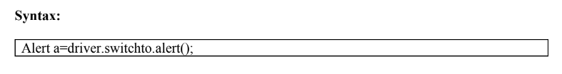
HANDLING ALERTS IN WEBDRIVER
We are using this option to handle alerts during execution time in application. Sometimes some alerts are interrupting application. Because of that we are unable to continue execution until close the alert message.
If any alert comes, we need to switch focus from driver to Alert using ‘switchTo’ method by using Alert Interface creating reference. With the help of reference, we can handle alerts.

Slide 3
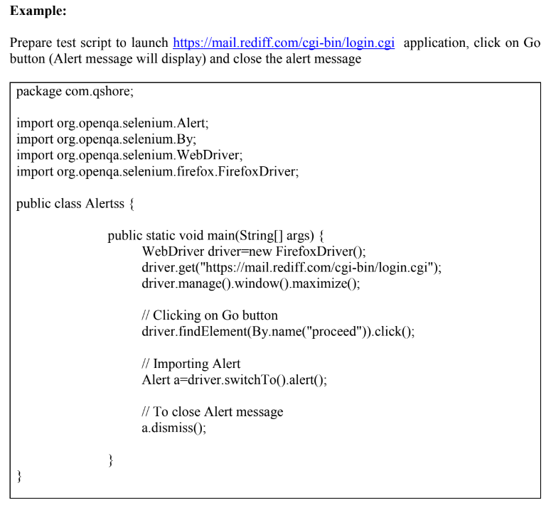

Slide 4

FAQs
What is Alert in Application
How to handle the Alert in Webdriver
How to Close the Alert
How to read the text from alert

Slide 5
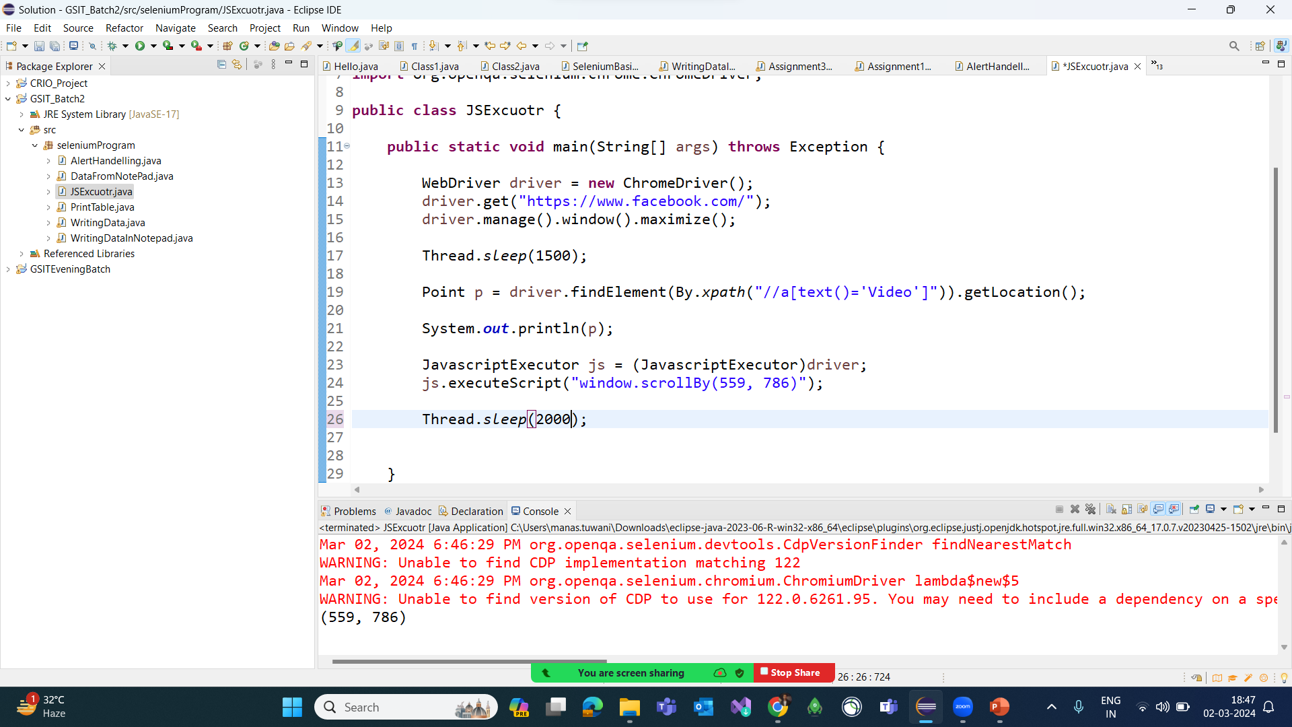
Handling Scrollbar Option

Slide 6
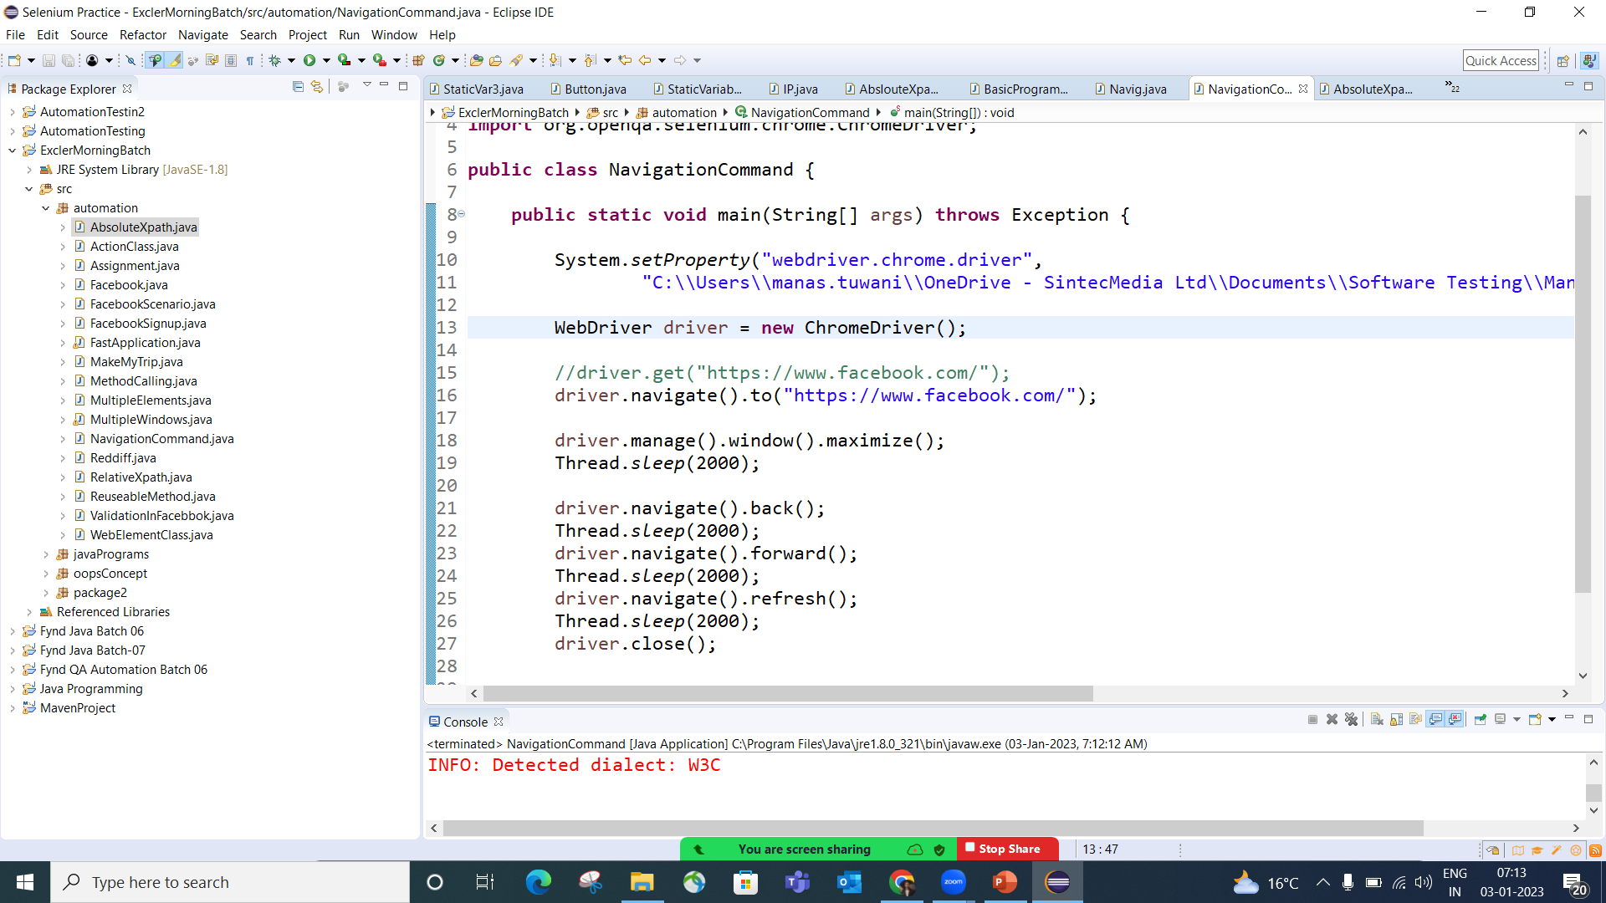
Navigation Command in Web driver

Slide 7
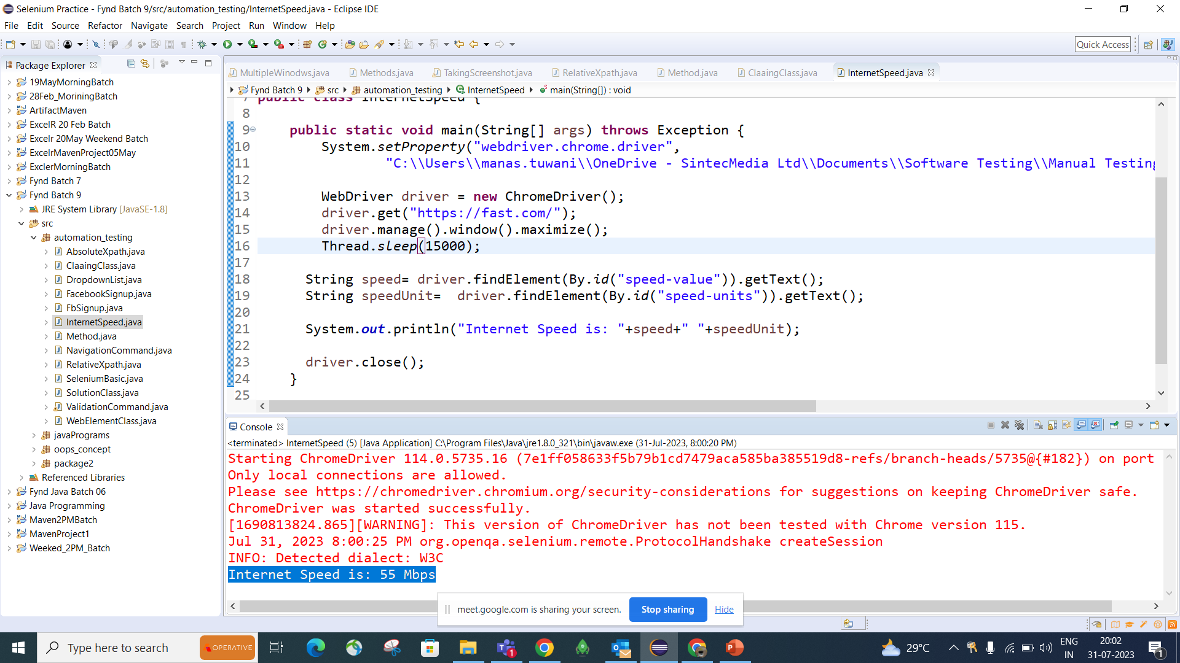
Checking Internet speed

